Slide 1
Hypothesis Testing
A process of testing hypotheses about parameters by setting up null and alternative hypotheses, gathering sample data, computing statistics from the samples, and using statistical techniques to reach conclusions about the hypotheses.
Slide 9-<number>

Slide 2
Steps in Testing Hypotheses
1. Establish hypotheses: state the null and alternative hypotheses.
2. Determine the appropriate statistical test and sampling distribution.
3. Specify the Type I error rate (α).
4. State the decision rule.
5. Gather sample data.
6. Calculate the value of the test statistic.
7. State the statistical conclusion.
8. Make a managerial decision.
Slide 9-<number>
Notes:
4

Slide 3
Null and Alternative Hypotheses
The Null and Alternative Hypotheses are mutually exclusive. Only one of them can be true.
The Null and Alternative Hypotheses are collectively exhaustive. They are stated to include all possibilities. (An abbreviated form of the null hypothesis is often used.)
The Null Hypothesis is assumed to be true.
The burden of proof falls on the Alternative Hypothesis.
Slide 9-<number>
Notes:
5

Slide 4
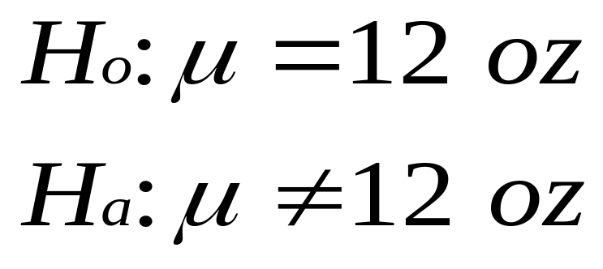
Null and Alternative
Hypotheses: Example
A soft drink company is filling 12 oz. cans with cola.
The company hopes that the cans are averaging 12 ounces.
Slide 9-<number>
Notes:
6

Slide 5
Rejection and Nonrejection Regions
Rejection Region
Rejection Region
Nonrejection Region
μ=12 oz
Critical Value
Critical Value
Slide 9-<number>
Notes:
7

Slide 6
Type I and Type II Errors
Type I Error
  Rejecting a true null hypothesis
  The probability of committing a Type I error is called α, the level of significance.
Type II Error
  Failing to reject a false null hypothesis
  The probability of committing a Type II error is called β.
  Power is the probability of rejecting a false null hypothesis, and equal to 1- β.
Slide 9-<number>
Notes:
8

Slide 7
Decision Table for Hypothesis Testing
Null True
Null False
Fail to
Correct
Type II error
reject null
Decision
(
)
β
Reject null
Type I error
Correct Decision
(Power)
(
)
α
Slide 9-<number>
Notes:
9

Slide 8
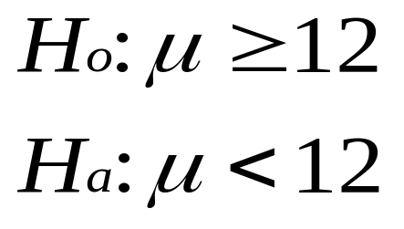
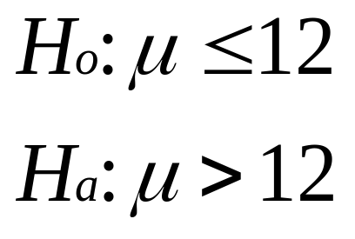
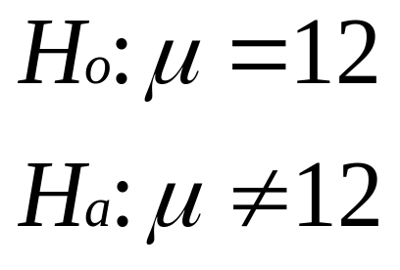
One-tailed and Two-tailed Tests
One-tailed Tests
Two-tailed Test
Slide 9-<number>
Notes:
10

Slide 9
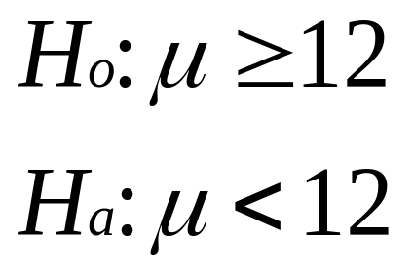

One-tailed Tests
Rejection Region
Rejection Region
Nonrejection Region
Nonrejection Region
μ=12 oz
μ=12 oz
Critical Value
Critical Value
© 2002 Thomson / South-Western
Slide 9-<number>
Notes:
11

Slide 10

Two-tailed Tests
Rejection
Region
Rejection
Region
Nonrejection Region
μ=12 oz
Critical Values
Slide 9-<number>
Notes:
12

Slide 11
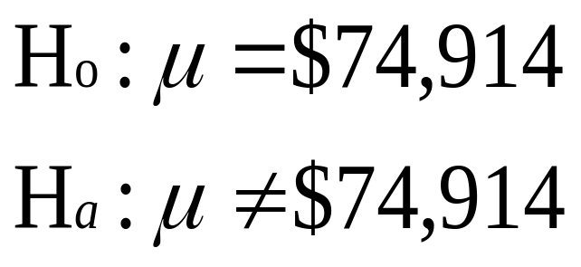
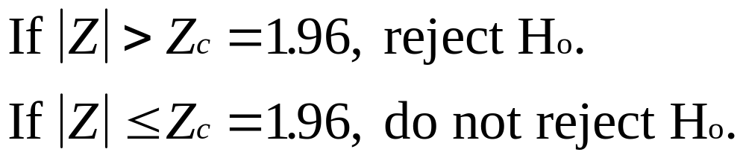
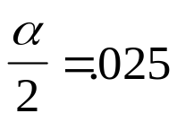
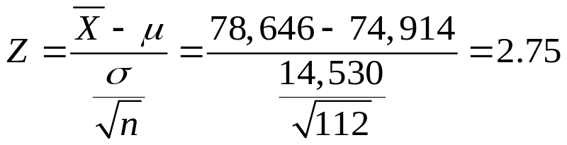



CPA Net Income Example:
Two-tailed Test
Rejection
Region
Rejection
Region
Nonrejection Region
Ζ=0
Slide 9-<number>
Notes:
13

Slide 12
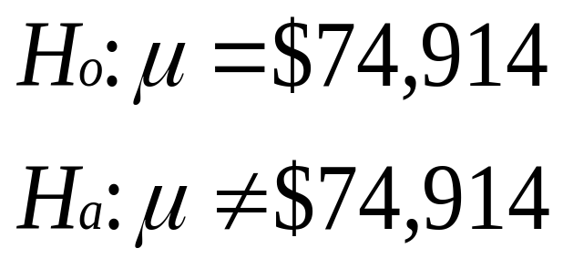
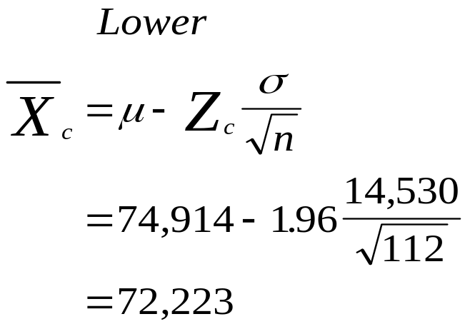
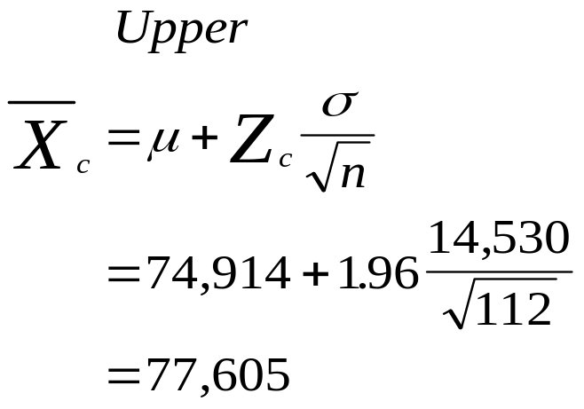
CPA Net Income Example:
Critical Value Method (Part 1)
Rejection
Region
Rejection
Region
Nonrejection Region
72,223
77,605
Ζ=0
Slide 9-<number>
Notes:
15

Slide 13
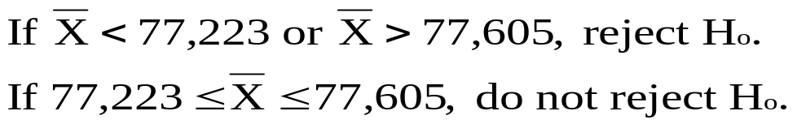
CPA Net Income Example:
Critical Value Method (Part 2)
Rejection
Region
Rejection
Region
Nonrejection Region
72,223
77,605
Ζ=0
Slide 9-<number>
Notes:
16

Slide 14
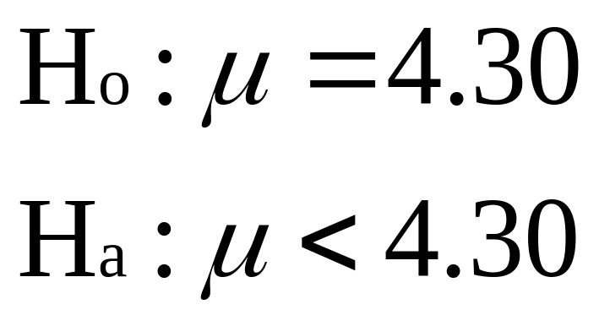

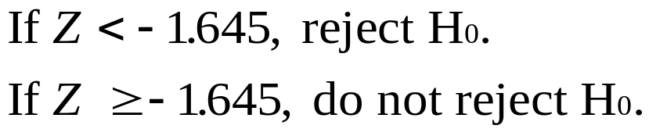
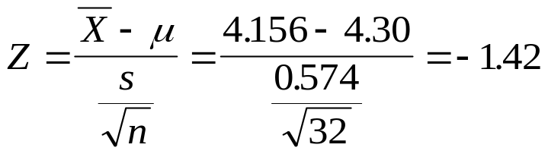
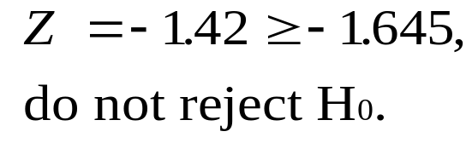
Demonstration Problem 9.1 (Part 1)
Rejection
Region
α=.05
Nonrejection Region
0
© 2002 Thomson / South-Western
Slide 9-<number>
Notes:
17

Slide 15
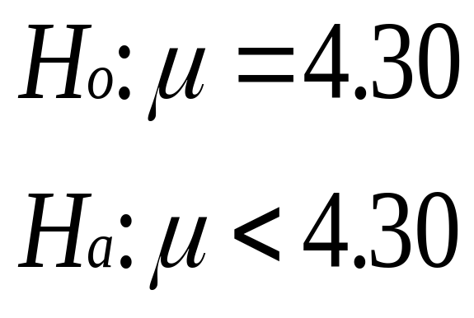
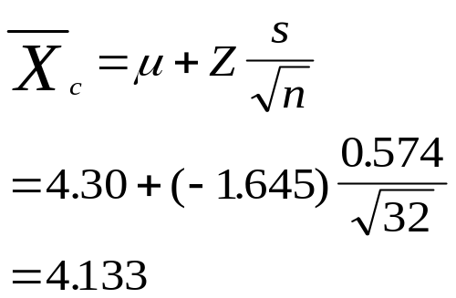
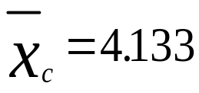
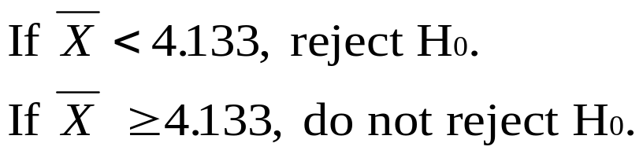

Demonstration Problem 9.1 (Part 2)
Rejection
Region
α=.05
Nonrejection Region
0
4.30
Slide 9-<number>
Notes:
18

Slide 16
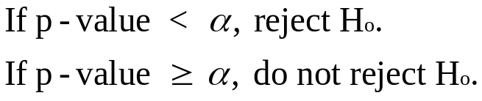
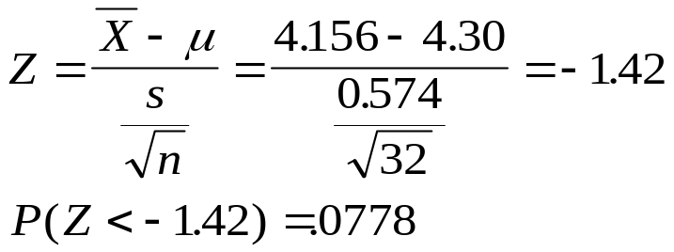
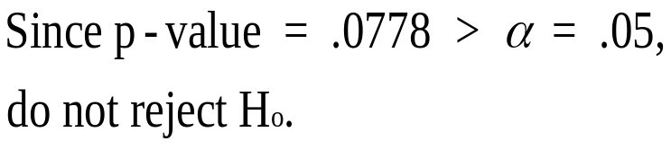
Demonstration Problem 9.1 (Part 3)
Rejection
Region
α=.05
Nonrejection Region
0
Slide 9-<number>

Slide 17
Two-tailed Test: Small Sample, σ Unknown, α = .05 (Part 1)
Weights in Pounds of a Sample of 20 Plates
22.6 22.2 23.2 27.4 24.5
27.0 26.6 28.1 26.9 24.9
26.2 25.3 23.1 24.2 26.1
25.8 30.4 28.6 23.5 23.6
Slide 9-<number>
Notes:
21

Slide 18
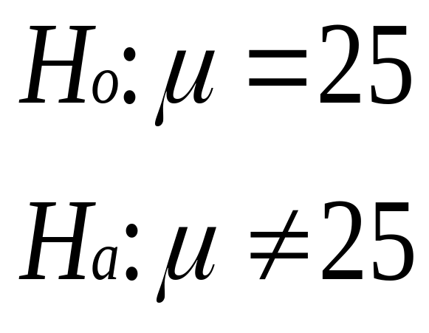
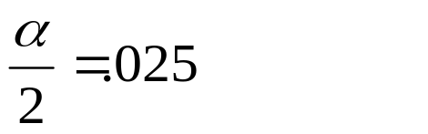
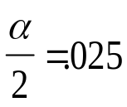



Two-tailed Test: Small Sample, σ Unknown, α = .05 (Part 2)
Rejection Regions
Nonrejection Region
Critical Values
Slide 9-<number>
Notes:
22

Slide 19
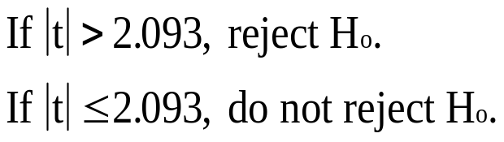
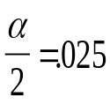
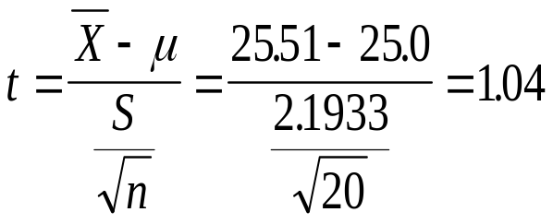

Two-tailed Test: Small Sample, σ Unknown, α = .05 (Part 3)
Rejection Regions
Non Rejection Region
Critical Values
© 2002 Thomson / South-Western
Slide 9-<number>
Notes:
23

Slide 20
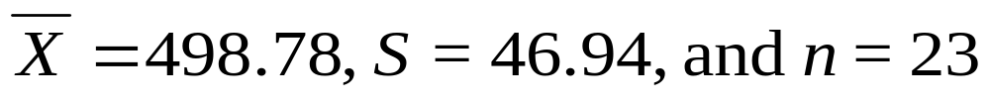
Demonstration Problem 9.2 (Part 1)
Size in Acres of 23 Farms
445 489 474 505 553 477 545
463 466 557 502 449 438 500
466 477 557 433 545 511 590
561 560
Slide 9-<number>
Notes:
25

Slide 21
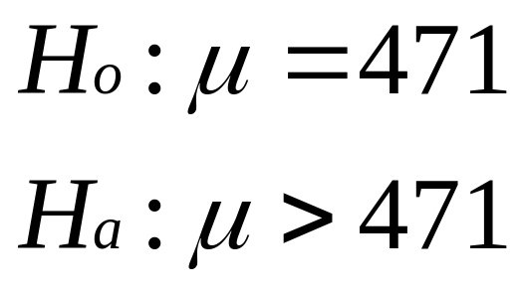

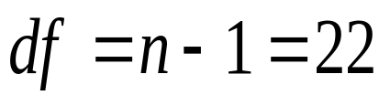

Demonstration Problem 9.2 (Part 2)
Rejection Region
Nonrejection Region
Critical Value
Slide 9-<number>
Notes:
26

Slide 22
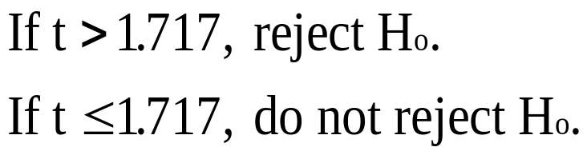
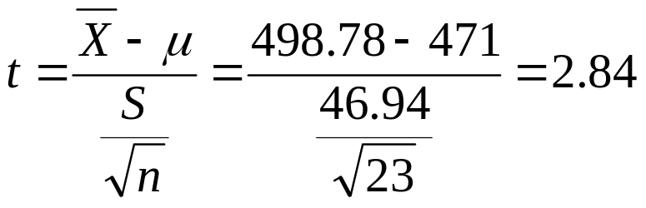

Demonstration Problem 9.2 (Part 3)
Rejection Region
Nonrejection Region
Critical Value
Slide 9-<number>
Notes:
27

Slide 23
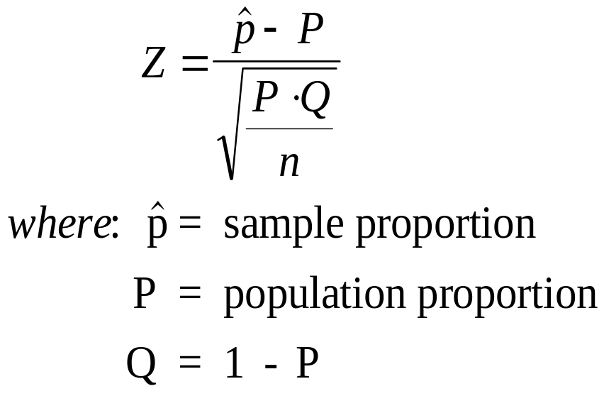
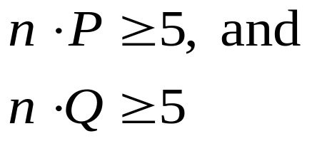
Z Test of Population Proportion
Slide 9-<number>
Notes:
28

Slide 24
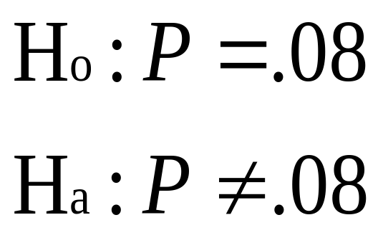
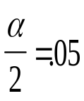
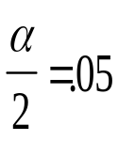


Testing Hypotheses about a Proportion: Manufacturer Example (Part 1)
Rejection Regions
Nonrejection Region
Critical Values
Slide 9-<number>
Notes:
29

Slide 25
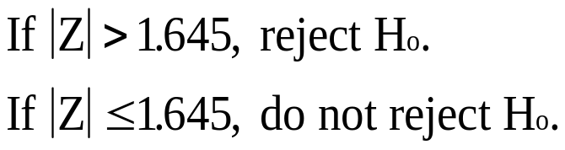
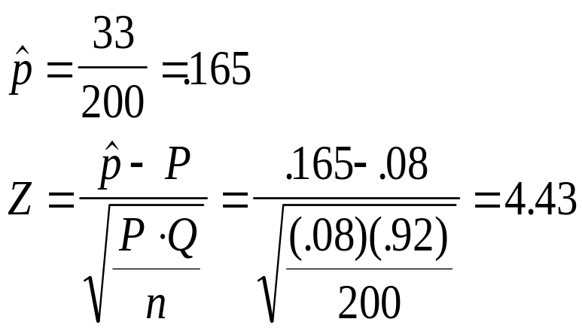

Testing Hypotheses about a Proportion: Manufacturer Example (Part 2)
Rejection Regions
Nonrejection Region
Critical Values
© 2002 Thomson / South-Western
Slide 9-<number>
Notes:
30

Slide 26
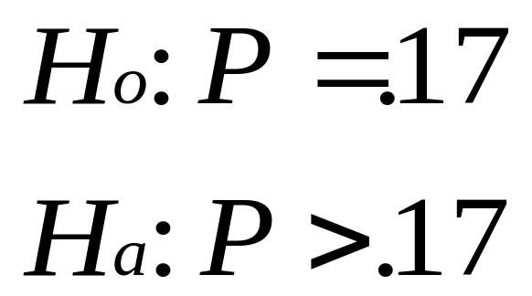

Demonstration Problem 9.3 (Part 1)
Rejection Region
Nonrejection Region
Critical Value
Slide 9-<number>
Notes:
31

Slide 27
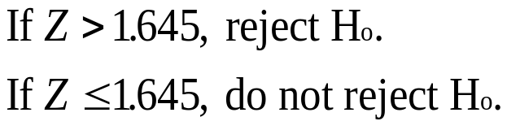
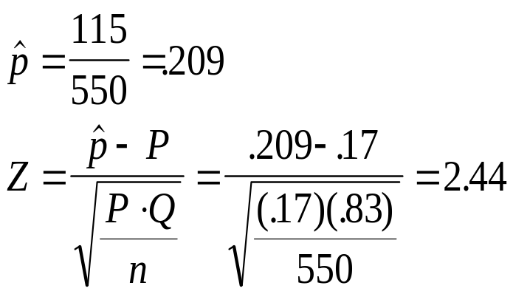

Demonstration Problem 9.3 (Part 2)
Rejection Region
Nonrejection Region
Critical Value
Slide 9-<number>
Notes:
32

Slide 28
Thank You
Slide 9-<number>

